Slide 1



User Manual
Simple yet Intelligent system to help user make smart decisions on choosing an Insurance policy.

Slide 2






01
Introduction
Table of Contents
02
Application Overview
06
Historical Transaction Prediction
03
Functions Explained
05
04
Dialogflow
Workflow
Click on each item for more info

Slide 3

Introduction
Agent
It has a user friendly intuitive interface, requires very minimal to nil user training for the system usage
SIMPLE
RECOMMENDER
Ability to provide intelligent personalized recommendation
Technologically advanced system design which is capable of understanding the user needs and perform intelligent evaluation.
Assessing the best insurance policy and being able to evaluate based on individual’s preferences can be very arduous task.
INTELLIGENT
INSURANCE
SINRA Singapore Intelligent Insurance Recommender Agent is a system which has considered the core features of design simplicity and intelligent performance to provide the insurance policy recommendation to the user by understanding their needs.

Slide 4
Application Overview
Here are the core areas of the system, click on each to view the system screenshots.
User Basic Information
Policy Preferences
Dialogflow
Feedback
Optimal Policy Recommender
Historical Preferred Policy Selection
Click on each item for more info

Slide 5
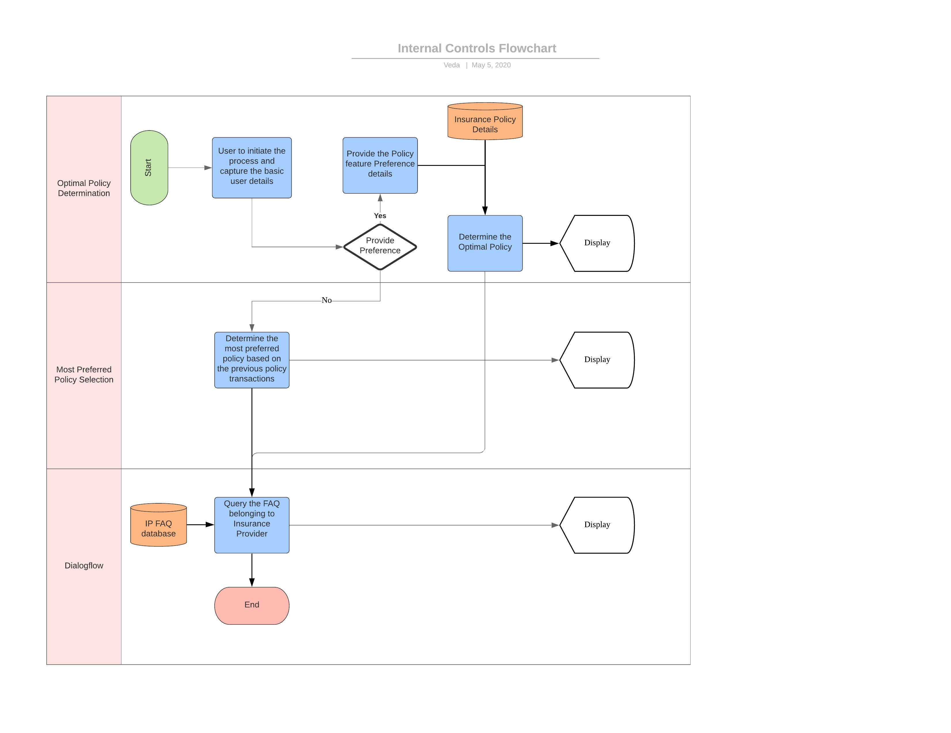
Flowchart

Slide 6

Dialogflow
Tailor-made bots to support the FAQ provided by different Insurance Providers.
User may want to check upon certain frequently asked questions about the policies/ insurance providers. By associating the FAQ and policy references with Dialogflow, the bot can respond to user queries

Slide 7
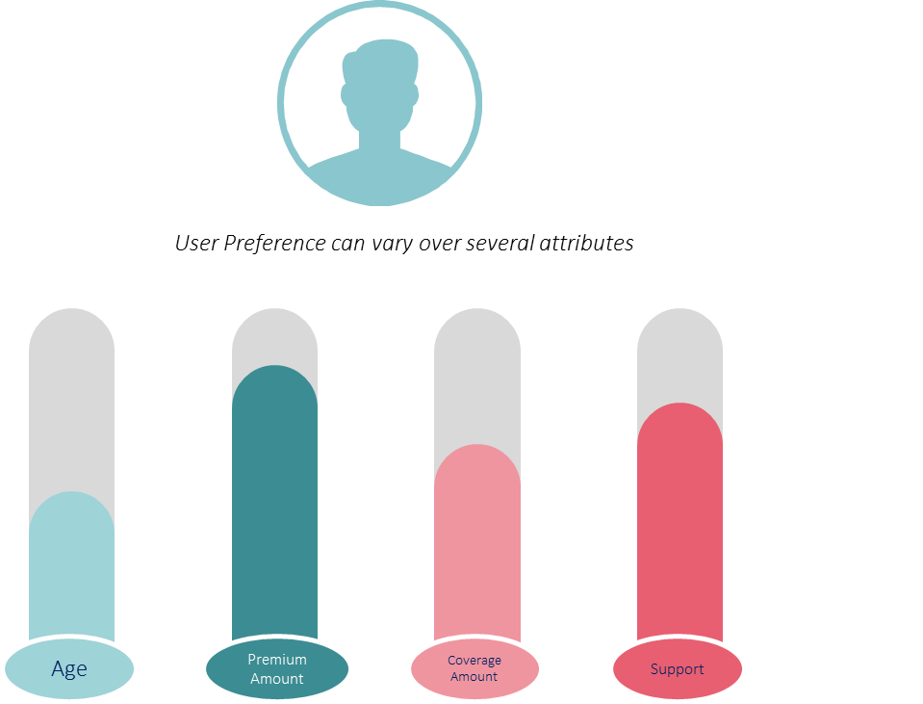
Optimal Policy Recommender
System has the information of all the policies currently provided by the various insurance providers including the features.
Upon capturing the user demographic details and the preferences, system will intelligently evaluate by filtering undesired policies and then applying the multi-criteria decision making model to normalize the applicable policies and then having hard and soft rules/ constraints determine the optimal policy

Slide 8
Historical Transaction Prediction
User Preference can vary over several attributes
Sometimes we may want to know how is the market trend? Which policy have the users whose preferences match with mine?
To answer such queries, the system also provides the user with option to look in to the previous transactions to predict the optimal preferred policy.
Age
Premium Amount
Coverage Amount
Support

Slide 9

THANK YOU

